Slide 1

ENSE Capstone Project
R2D2s
Notes:
Hi Everyone,
So, this time ill be doing the vlog alone-ish because Nik, Nisarg, and Shrey have midterms.

Slide 2
Members
Nikita Khavronin
Shrey Patel
Nisarg Shah
Mayank Vashisht
Notes:
we are the R2D2s. We are all last year SSE students at the U of R.
I am Mayank and I really enjoy project management aspect of the software design process. That is what I am doing for the project, along with front end development
Nikita is the one who came up with our project idea. He works on software development projects as a freelancer in his free time. He and Shrey primarily work on the back-end in this project.
Nisarg actually worked on the latest iteration of the OBA software for the u of r. He is working on the front-end for this project.

Slide 3

Project Idea
A live-streaming service that lets users translate live-streamed content to the users’ preferred language.

Slide 4

Why?
We live in an increasingly connected world. We believe that not being able to speak a specific language should not keep someone from accessing content and our proposed project will help with it.

Slide 5
How?

Slide 6
Status
Green

Slide 7

Why we think So?

Slide 8

Whats has changed since last time?
Notes:
Since last time we have changed the database from java to python.

Slide 9
Documents
KanBan board
Timeline
GitHub
Project Charter
RACI Chart
Stakeholder Analysis
Business Case
ERD

Slide 10
Community Feedback
Eric D.
Improve UI. Keep it clutter free.
Asian Languages are a must
Madhav V.
Must support two-way translation.
Spanish should be the priority because of its prominence
Amelia C.
Stream chats should also be translated
If possible, eliminate the use of third-party screen capture application.

Slide 11
Planned Languages
English
Spanish
Russian
German
French
Italian
Arabic
Chinese
Hindi
Portguese

Slide 12
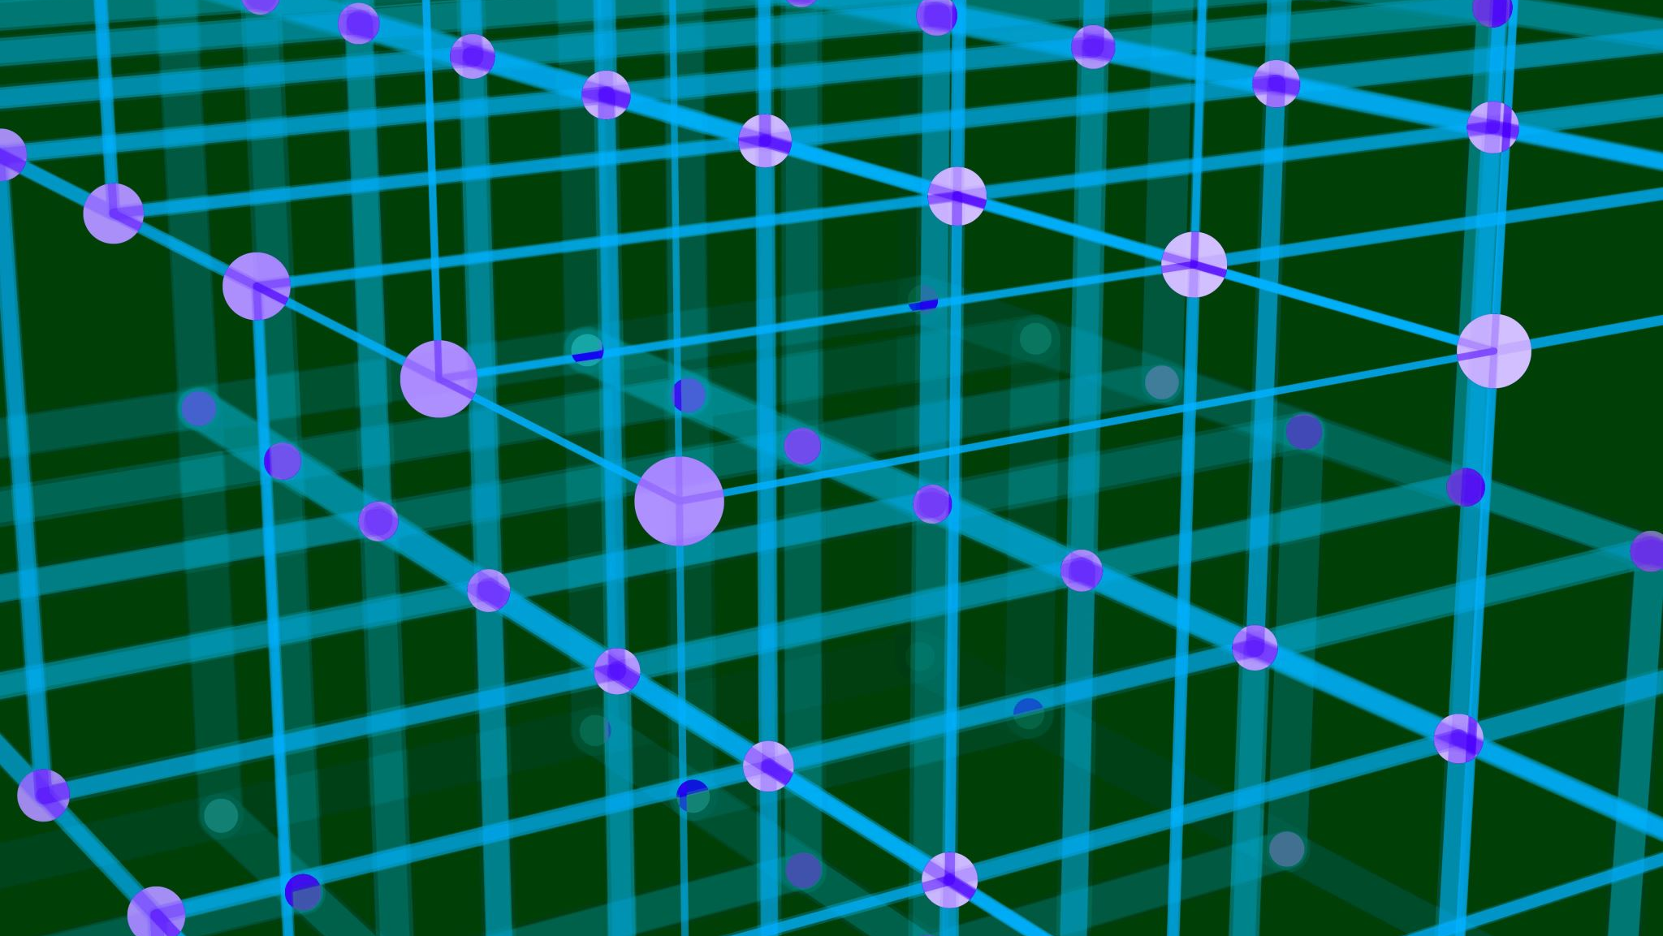
Constraints
Notes:
Limited time
Learning as we go. First interaction with tech being used.
Limited help from the mentor.

Slide 13

Questions?

